Slide 1

JusticeAI
AI-Powered Legal Awareness & Assistance Platform
B.Tech Computer Science · Academic Project Presentation

Slide 2
Meet Our Team
Three dedicated individuals collaborating to bring JusticeAI to life.
FARHAAN HUSAIN
MD EBAD
RAHBAR AALAM
ROLL NO. : 236047
ROLL NO. : 233030
ROLL NO. : 236010
BTECH (CST)
BTECH (CSE)
BTECH (CST)

Slide 3

The Problem: Legal Knowledge Gap
Lack of Legal Awareness
Most citizens are unaware of their fundamental rights, legal procedures, and remedies available under Indian law.
Complex Legal Terminology
Legal language is dense, technical, and inaccessible to non-lawyers — creating a barrier to justice.
No Accessible Guidance
There is no free, instant, and structured digital system to guide citizens through everyday legal queries.

Slide 4
Project Objectives
Simplify Legal Knowledge
Provide Instant Assistance
Break down complex legal concepts into plain, easy-to-understand language for every citizen.
Offer real-time, chatbot-driven legal guidance accessible 24/7 without any consultation fees.
Promote Rights Awareness
Ensure Accessibility
Educate users on Fundamental Rights, consumer laws, traffic regulations, and civic duties.
Build a fully responsive, mobile-friendly platform usable across all devices and network conditions.

Slide 5

Proposed Solution: JusticeAI Platform
JusticeAI is a web-based legal awareness and assistance platform that bridges the gap between citizens and legal knowledge through three integrated pillars:
AI Chatbot
Law Learning System
Legal Courses
Rule-based (current) → NLP-powered (future) conversational legal guidance
Structured modules on traffic laws, FIR filing, RTI, and consumer rights
Step-by-step courses on Fundamental Rights, Land Law, and more

Slide 6
Key Features
Chatbot Assistance
Law Learning System
Instant legal Q&A with intent classification and contextual responses.
Interactive modules on FIR, RTI, traffic challans, and consumer rights.
Legal Courses
Search & Filter
Structured courses on Fundamental Rights, Traffic Law, and Land Law.
Quickly locate relevant laws, articles, and guidance by category.
Responsive UI
Traffic Challan Help
Bootstrap-powered, fully mobile-friendly interface for all screen sizes.
Guidance on challenging wrongful traffic fines and understanding violations.

Slide 7
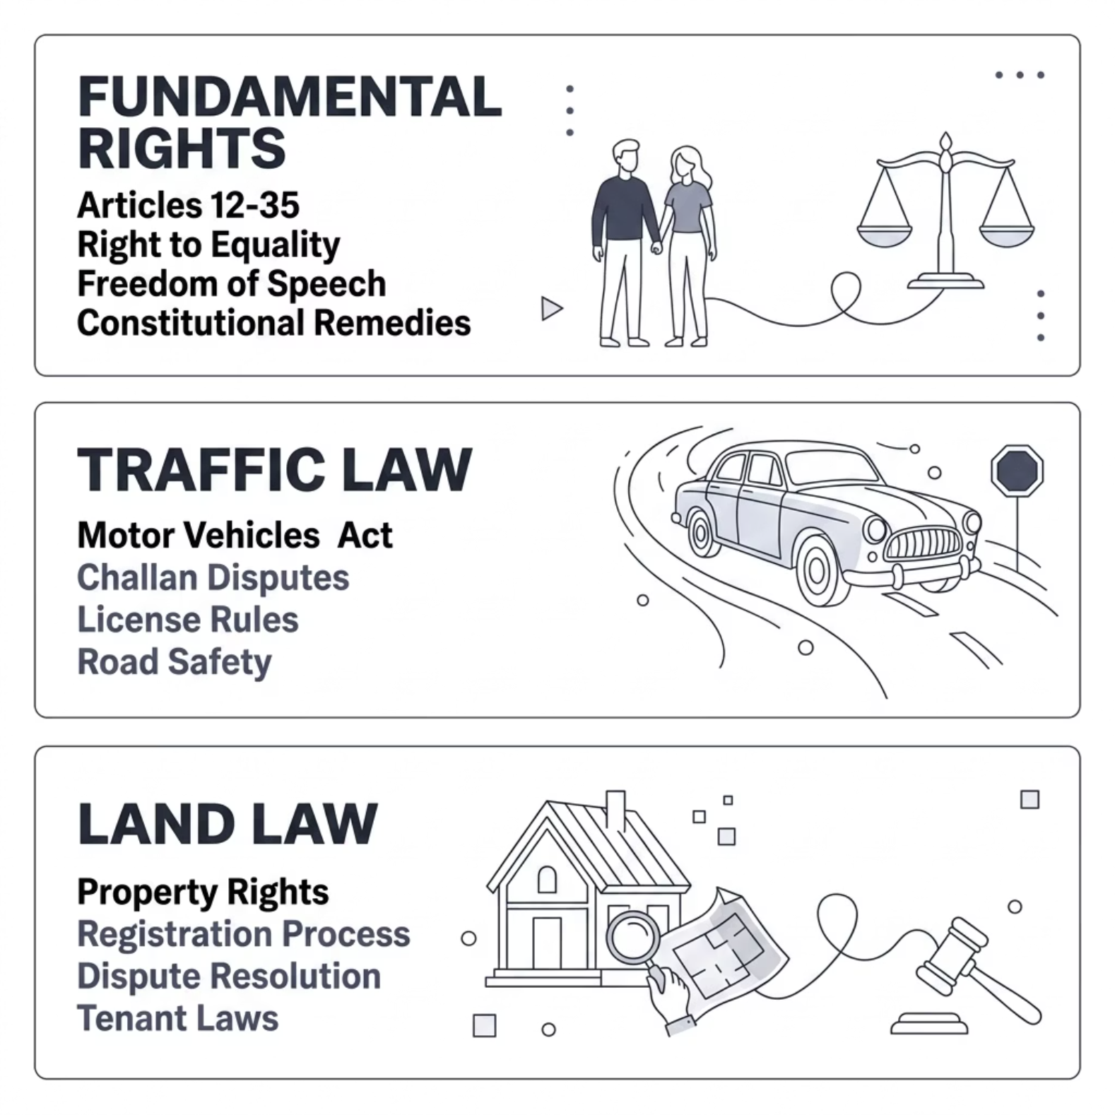


Legal Courses Module
Structured Learning Approach
Each course follows a step-by-step curriculum — from basic concepts to practical application — making legal education accessible to non-lawyers.
Fundamental Rights — Articles 12–35, enforcement mechanisms
Traffic Law — MV Act provisions, challan disputes, license rules
Land Law — Property rights, registration, dispute resolution
Courses include quizzes, summaries, and real-world scenario examples for better retention.

Slide 8

Technology Stack
Architecture Philosophy
✅ Frontend — Implemented
🔲 Backend — Planned
JusticeAI is built with a scalable, layered architecture. The current frontend-only implementation ensures a polished user experience, while the planned backend and AI layers will enable persistent data, user authentication, and intelligent query processing.
HTML5 & CSS3
JavaScript ES6
Bootstrap (Responsive)
Node.js & Express.js
MongoDB (Database)
REST APIs
The modular design allows each layer to be upgraded independently without disrupting existing functionality.
🤖 AI — Future Scope
OpenAI / Gemini API
NLP Intent Recognition
Smart Recommendations

Slide 9


System Architecture & Workflow
Enter Query
Process Input
Classify Query
Select Module
The diagram above illustrates the end-to-end user journey — from query input through classification, module selection, and response delivery.
Architecture Layers
DFD Level 0 — Overview
User Layer
Frontend Layer
External Entity: User submits queries via web interface.
Browser / Mobile Device
HTML · CSS · JS · Bootstrap
Processes: Chatbot Engine, Law Module, Course Module process requests.
Backend Layer (Planned)
Data & AI Layer (Planned)
Data Store: MongoDB stores legal content, user sessions, and course data.
Node.js · Express · REST APIs
MongoDB · OpenAI/Gemini API
Output: Contextual legal response or course recommendation returned to user.
Currently frontend-based — backend & AI layers are planned for the next development phase.

Slide 10
Module Breakdown & Use Case
Core Modules
Use Case: Wrong Traffic Challan
1
2
01
User reports wrongful challan
Chatbot Module
Law Learning Module
02
Rule-based engine with keyword matching and category routing.
Curated articles on FIR, RTI, traffic laws, and consumer rights.
System identifies issue category
03
3
4
Relevant MV Act section provided
Legal Courses Module
UI/UX Module
04
Responsive Bootstrap interface with intuitive navigation.
Dispute process & next steps shown
Structured courses with progress tracking and assessments.

Slide 11
Challenges, Future Scope & Conclusion
Challenges Faced
Future Roadmap
Chatbot Logic — Designing accurate rule-based responses for diverse legal queries
UI Responsiveness — Ensuring consistent layout across mobile, tablet, and desktop
Dynamic Data — Managing legal content updates without backend persistence
Backend — Node.js + MongoDB + REST APIs
AI Chatbot — NLP via OpenAI / Gemini API
Voice Assistant — Speech-to-text for accessibility
Multilingual — Hindi and regional language support
Auth & Dashboard — User accounts with saved history
Conclusion
Thank You
JusticeAI demonstrates how accessible technology can democratize legal knowledge. It delivers a functional, responsive frontend with a clear path toward full AI-powered legal assistance — a meaningful step toward digital justice in India.
We appreciate your time and evaluation. We welcome your questions, feedback, and suggestions.
ANY QUESTIONS?

